Slide 1
Introduction to Operating Systems
CPSC/ECE 3220 Spring 2020
Lecture Notes
OSPP Chapter 1
(adapted by Mark Smotherman from Tom Anderson’s slides on OSPP web site)

Slide 2
Chapter 1
Operating system definition
Software to manage a computer’s resources for its users and applications
OS roles
Referee, illusionist, and glue
Core ideas
Protection, concurrency, resource allocation, virtualization, reliable storage

Slide 3
What is an operating system?
Software to manage a computer’s resources for its users and applications

Slide 4
Operating System Roles
Referee (“more constrained”)
Resource allocation among users and applications
Isolation of users and applications from each other
Communication between users and applications
Illusionist (“more powerful”)
Each application appears to have a machine to itself
Physical limitations and details are masked
Higher-level objects are provided, such as files
Glue (“more useful”)
Execution environment with common set of services
Files written by one app can be read by another

Slide 5
Example: File Systems
Referee
Prevent users from accessing each other’s files without permission
Illusionist
Files and directories
Files can grow (nearly) arbitrarily large
Character or block I/O whether disk or network
Disk details such as sector size are hidden
Glue
open(), fprintf(), fscanf()

Slide 6
Protection – Chapter 2
The isolation of potentially misbehaving applications and users so that they do not corrupt other applications or the OS itself
Prevent corruption of memory and files
Prevent denial of service (DoS) to other users by unstoppable infinite loop on CPU
Prevent crash of one application causing whole system to crash

Slide 7
Key Ideas for Protection
Hardware support
Two execution modes: Kernel and User
Memory protection
A user process is a separate protection domain
User processes run in user mode and can only access their own subset of memory locations
The instructions to change memory protection are valid only in kernel mode, which is reserved for the OS
Protects other users as well as the OS

Slide 8
System Call Interface – Chapter 3
Process management
Interprocess communication
OS structure
One monolithic program (early designs)
Layered approach (more recent designs)

Slide 9
Concurrency – Chapters 4-6
Multiple activities that can happen at the same time
Real concurrency: multiple CPUs
Apparent concurrency: time sharing on single CPU
Multiple threads executing within the context of a process
Shared memory
Synchronization approaches for atomic updates

Slide 10
Resource Allocation – Chapters 6-7
Resource: a physical or virtual entity that can be assigned to a user or application
E.g., OS decides how much CPU time and when, how much memory and when
OS may limit allocations for purposes of efficiency and fairness
OS controls the sharing of resources

Slide 11
Virtualization – Chapters 8-10
Provide an application with the illusion of resources that are not physically present
May be within a physical machine, such as virtual memory, or may be a full virtual machine

Slide 12
Reliable Storage – Chapters 11-14
Safely store user data even if the system crashes due to software errors or hardware failures
Update multiple blocks of storage in a single transaction, which can be restarted on failure
For example:
Write a list of intended changes to a log file
Write a commit record to indicate end of list
Make the changes to the storage blocks
Reclaim the space in log

Slide 13
Question
How should an operating system allocate processing time between competing uses?
Give the CPU to the first to arrive?
To the one that needs the least resources to complete? To the one that needs the most resources?
Design choices represent trade-offs

Slide 14
Example: Web Service
How does the server manage many simultaneous client requests?
How do we keep the client safe from spyware embedded in scripts on a web site?
How do make updates to the web site so that clients always see a consistent view?

Slide 15
OS Challenges
Reliability
Does the system do what it was designed to do?
Availability
What portion of the time is the system working?
Mean Time To Failure (MTTF), Mean Time to Repair (MTTR)
Availability = MTTF / (MTTF + MTTR)
Security
Can the system be compromised by an attacker?
Privacy
Data is accessible only to authorized users

Slide 16
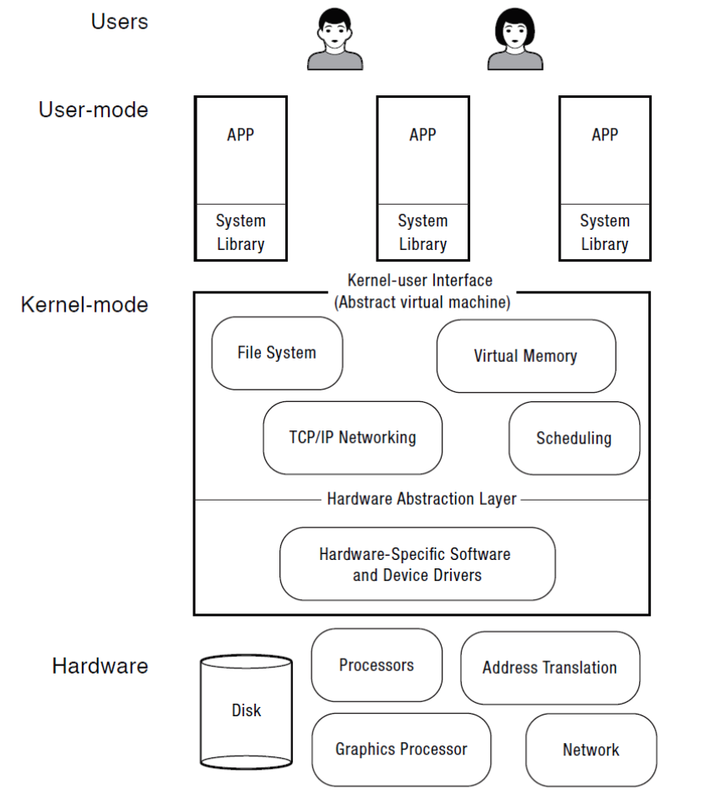
OS Challenges
Portability
For programs:
Application programming interface (API)
Abstract virtual machine (AVM)
For the operating system
Hardware abstraction layer

Slide 17
OS Challenges
Performance
Latency/response time
How long does an operation take to complete?
Throughput
How many operations can be done per unit of time?
Overhead
How much extra work is done by the OS?
Fairness
How equal is the performance received by different users?
Predictability
How consistent is the performance over time?

Slide 18
Abbreviated OS History

Slide 19
Selected OS Developers
1960s
Fred Brooks (manager) – IBM OS/360
Fernando Corbató (project leader) – Multics
1970s
Dave Cutler – DEC VMS (and later Windows NT)
Dennis Ritchie and Ken Thompson – UNIX
1980s
Rick Rashid – Mach
1990s
Linus Torvalds – Linux

Slide 20
Computer Performance Over Time

Slide 21
Early Operating Systems: Computers Were Very Expensive
One application at a time
Had complete control of hardware
Runtime library was a primitive OS
Users would stand in line to use the computer
Batch systems
Keep CPU busy by having a queue of jobs
OS would load next job while current one runs
Users would submit jobs and wait

Slide 22
Time-Sharing Operating Systems: Computers and People Both Expensive
Multiple users on computer at same time
Multiprogramming: run multiple programs at same time
Interactive performance: try to complete everyone’s tasks quickly
As computers became cheaper, more important to optimize for user time, not computer time

Slide 23
Today’s Operating Systems: Computers Are Cheap
Smartphones
Embedded systems
Laptops
Tablets
Virtual machines
Data center servers

Slide 24
Tomorrow’s Operating Systems
Giant-scale data centers
Increasing numbers of processors per computer
Increasing numbers of computers per user
Very large scale storage

